Slide 1

CRITICAL EVALUATION OF JOURNAL ARTICLE
BY
DR.AARTHI PRIYANKA
POST GRADUATE
DEPARTMENT OF PHARMACOLOGY

Slide 2
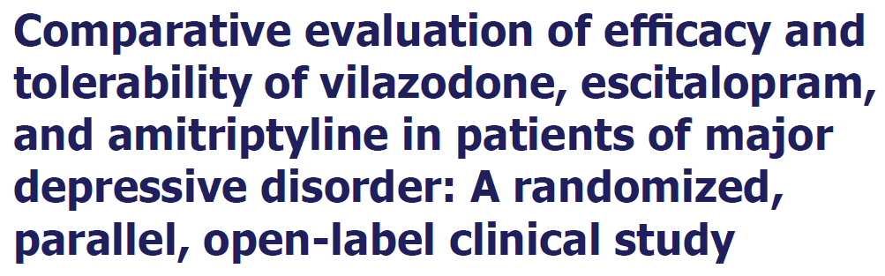
Indian Journal of Pharmacology - Volume 52, Issue 2, June 2020

Slide 3
TITLE
No suggestion in title

Slide 4
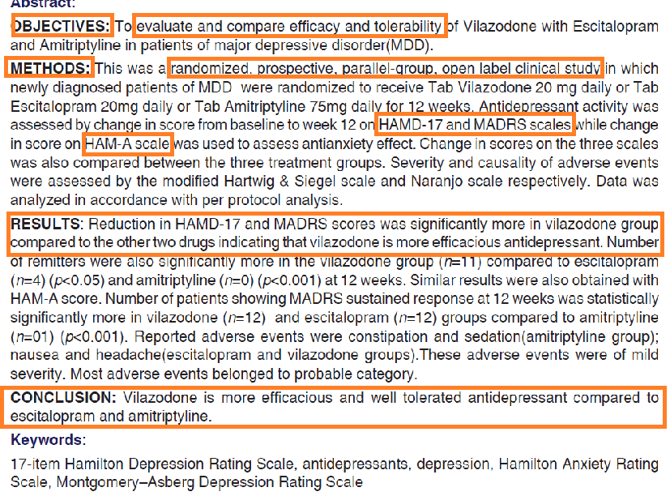

Abstract
The author has mentioned the
Objective - mentioned
secondary objective - anxiety
Trial design
Methods
Results
Conclusion

Slide 5
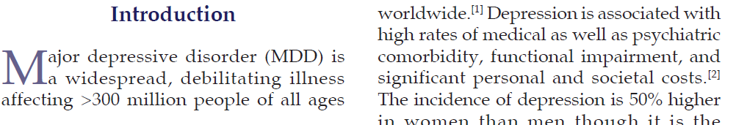
INTRODUCTION
Scientific background of the study.
The author has explained rationale of why he has chosen this disease.

Slide 6
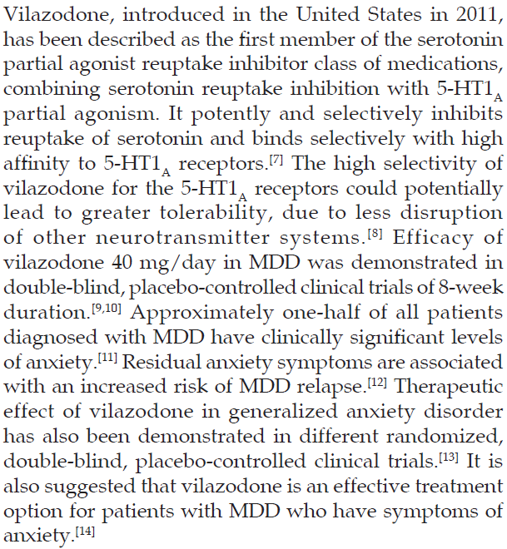
INTRODUCTION
The author has explained the rationale of
why he has chosen this drug

Slide 7
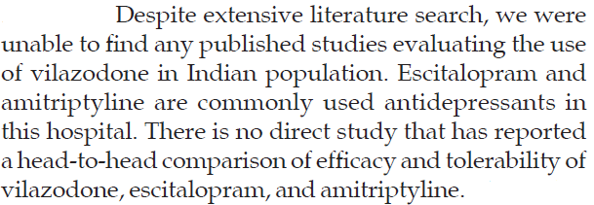
INTRODUCTION
The author has explained the rationale of choosing this study.

Slide 8

INTRODUCTION
Objective of the study
secondary objective - anxiety

Slide 9


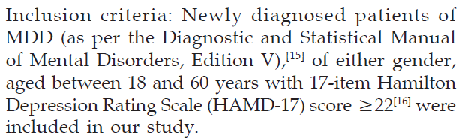
METHODOLOGY
Author has mentioned about,
Trial design
Location
Eligibility criteria

Slide 10
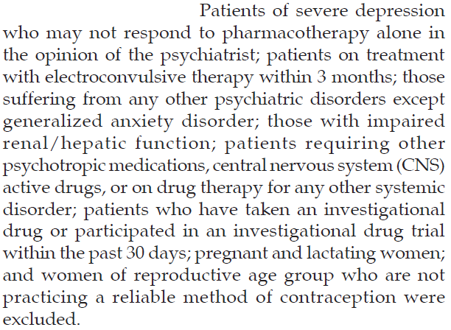
METHODOLOGY
Exclusion criteria

Slide 11


METHODOLOGY
Intervention to each group
- assigned random number to patients
Allocation sequence – who done is not mentioned
Author dint mention about details of drug administration ( as TCA causes sedation whether they given them at night and SSRI may cause insomnia whether they given them at morning )

Slide 12
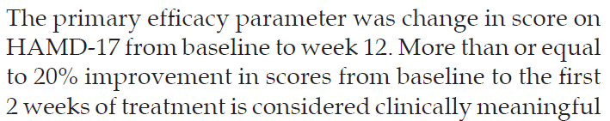
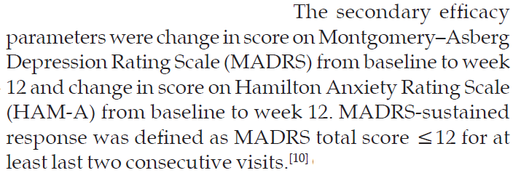
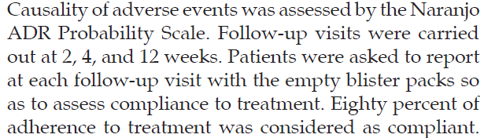
METHODOLOGY
Outcome assessment

Slide 13
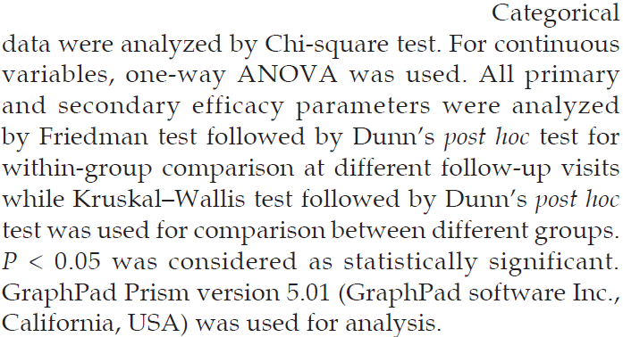
METHODOLOGY
Statistics used for data analysis

Slide 14
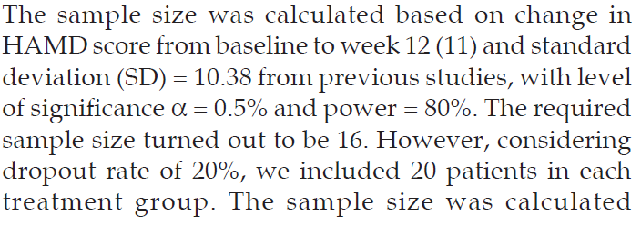
METHODOLOGY
Sample size calculation

Slide 15
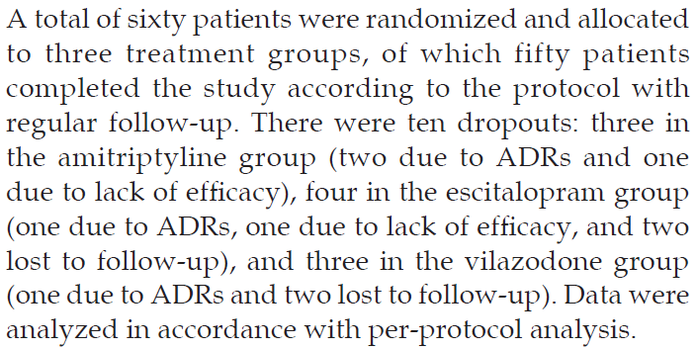
CONSORT DIAGRAM
Not mentioned in diagram
But mentioned in paragraph

Slide 16
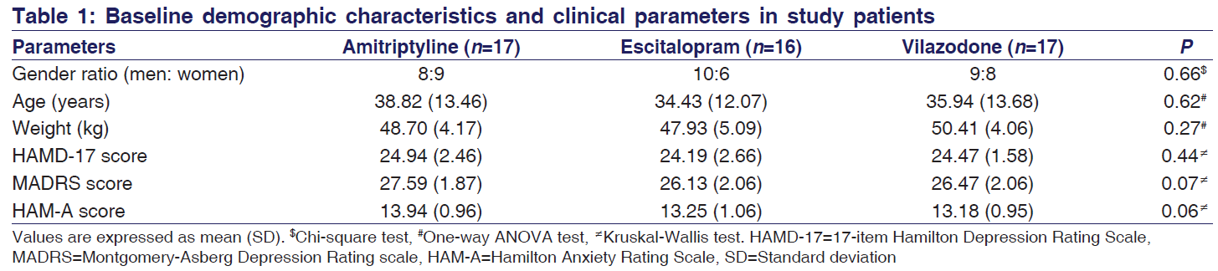
RESULTS
Baseline data, Numbers analyzed
Outcomes are estimated with P value

Slide 17
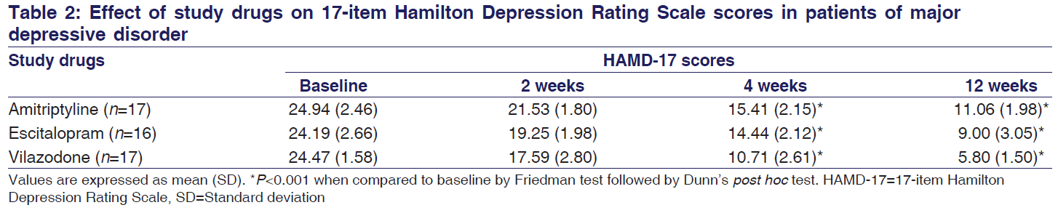
RESULTS

Slide 18
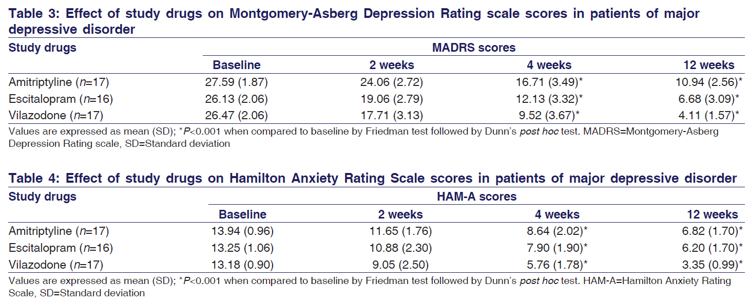
RESULTS

Slide 19
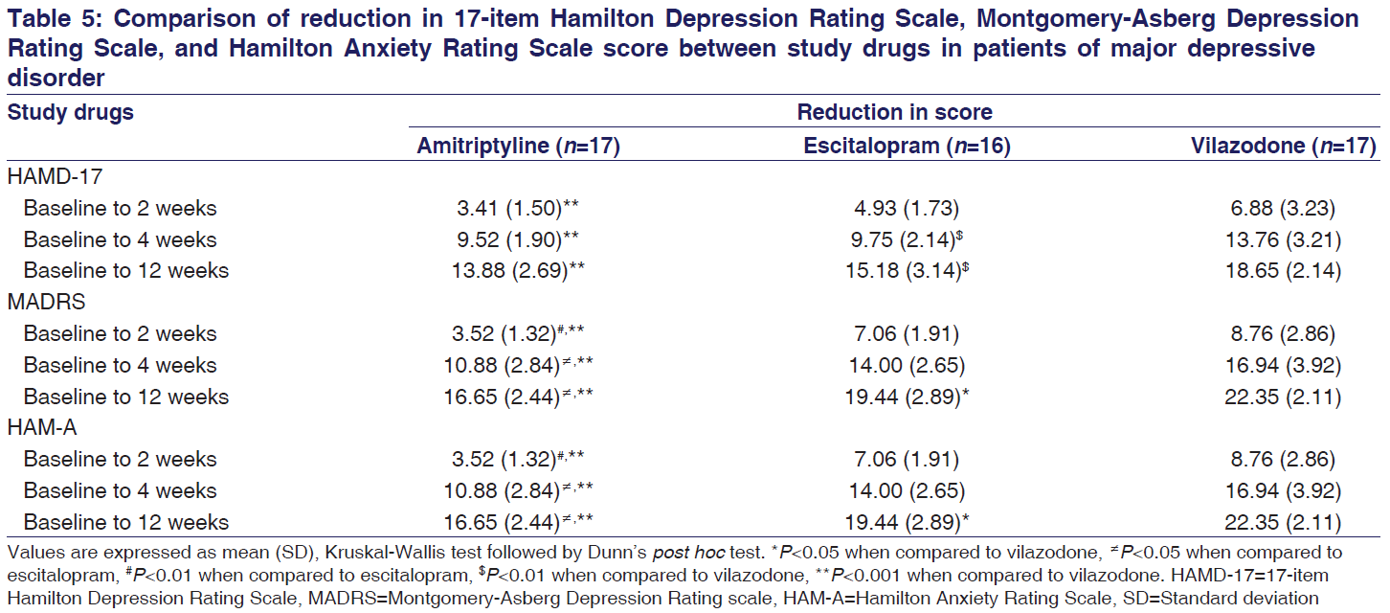
RESULTS

Slide 20
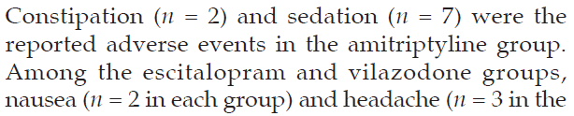
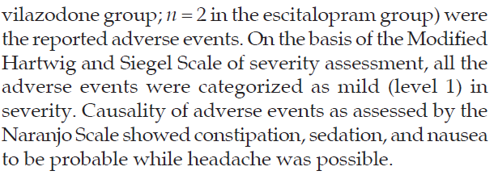
HARMS
Mentioned
Sexual dysfunction,weight gain – not mentioned

Slide 21
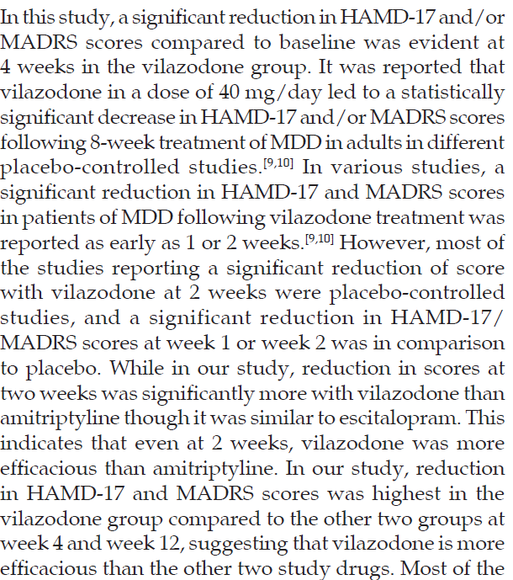
DISCUSSION
Interpretation of study results
Generalizability

Slide 22
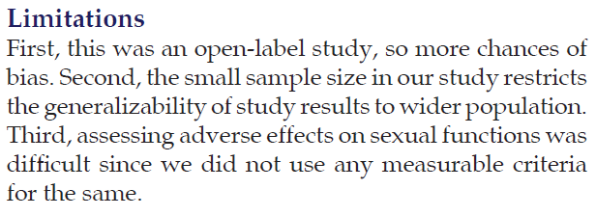
DISCUSSION
Limitations of the study was mentioned

Slide 23
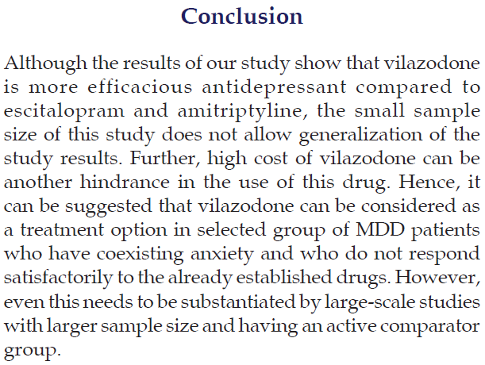
CONCLUSION
Author concluded the study with his objective

Slide 24
Others
Vancouver referencing
Author has mentioned about funding – PI got medicines by himself and distributed to the patients free of cost

Slide 25
THANK YOU

